Slide 1
Basic Neural Network
Multilayer Perceptron

Slide 2
What is Multilayer Perceptron?
Multilayer Perceptron is a feedfoward artificial neural network (ANN) that takes sets of inputs and it goes through a training process to return outputs.
An multilayer perceptron made of at lease three layers: input layer, hidden layer and output layer.
The training process or the supervised learning technique used inside of multilayer perceptron is called backpropagation.

Slide 3
What is backpropagation?
Backpropagation is a popular algorithm used in FNN (feedfoward neural network).
Backpropagation as a technique uses gradient descent: is that it computes the gradient of the cost function with respect to the network weight. Then after computation of the last layer it iterates backward from the last layer (which is the one directly connected to the cost function, as it is the one that provides the prediction) to the first layer to avoid redundant calculations.

Slide 4
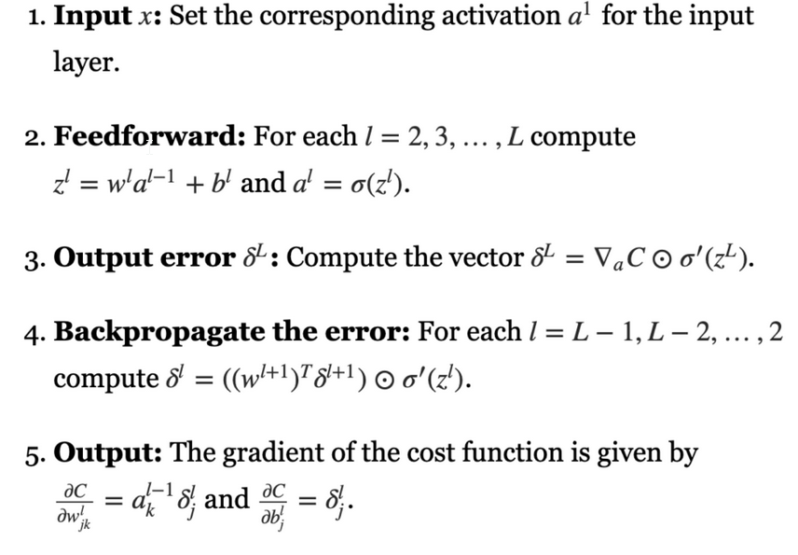
Backpropagation algorithm:

Slide 5
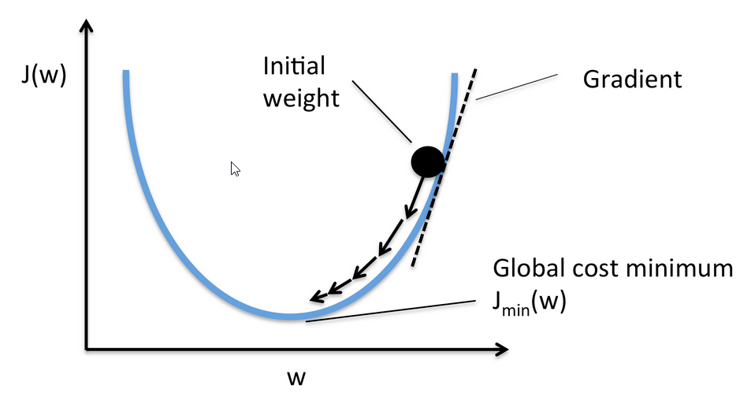
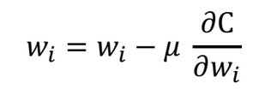
Gradient descent:
Learning weight of cost function in this case MSE or cross entropy function:

Slide 6
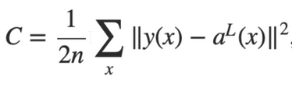
Backpropagation algorithms with Mean Squared Error (MSE)
Formula of Mean Squared Error:

Slide 7
Backpropagation algorithms with cross entropy
Formula of cross entropy:
H(p,q) = H(p) + Dkl(p||q), where:
Dkl(p||q) =
H(p) =

